Slide 1
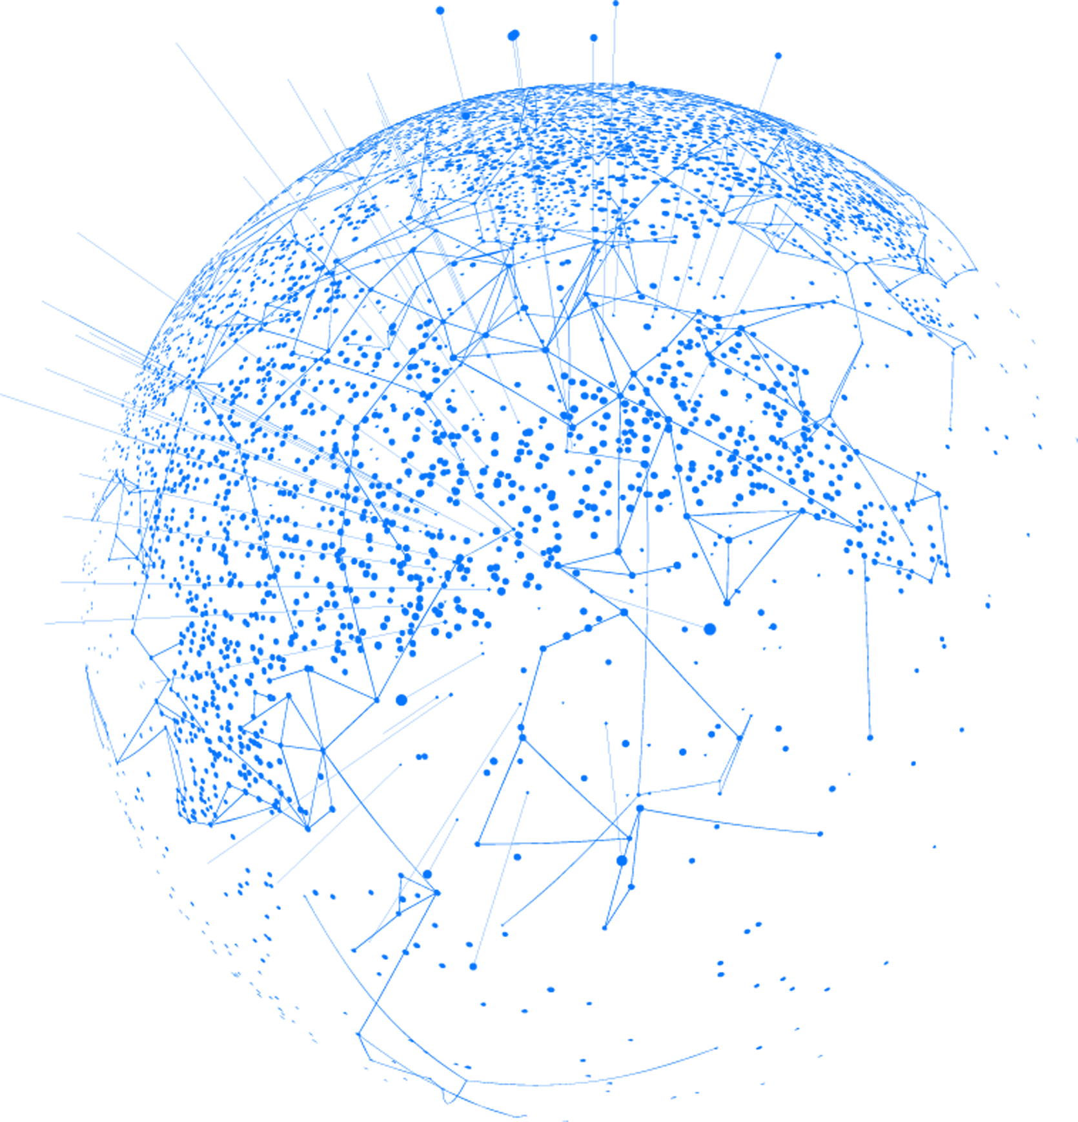


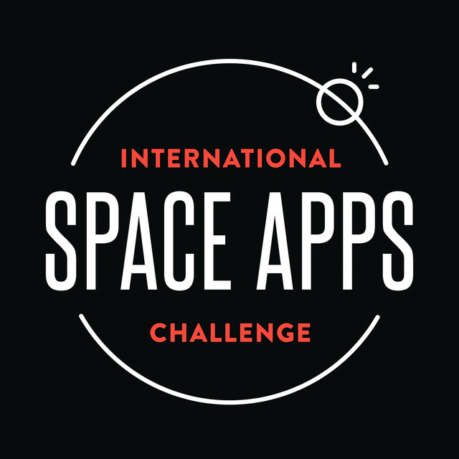

NASA SPACE APPS
We are
SPACE VOYAGERS
EVA PROJECT

Slide 2

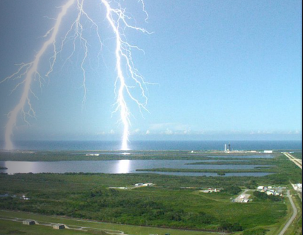
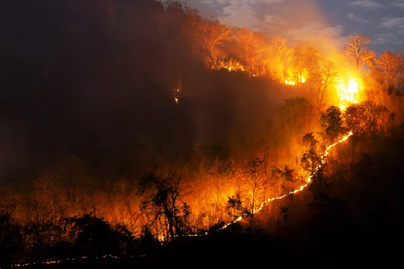
NASA CHALLENGE
Image our Connected Earth.
Inspired by the problem of forest fires in our country and their impact on public health and the ecosystem.

Slide 3
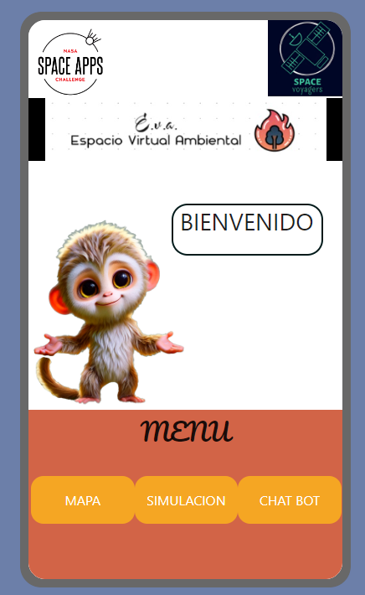
EVA
“Wake up, the world is changing. Discover the Effect of wildfires with a click”
Espacio virtual Ambiental is an educational app for young people that uses NASA satellite data to show the impact of wildfires and climate change.

Slide 4
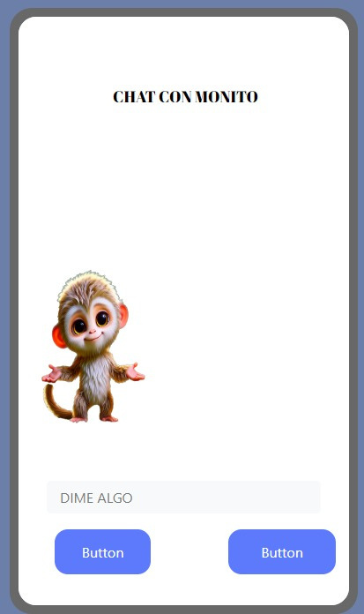

MALLKU
EVA uses an interactive map with real-time fire, pollution and temperature data, and a chatbot called Mallku that guides the user through dynamic lessons with quizzes.

Slide 5
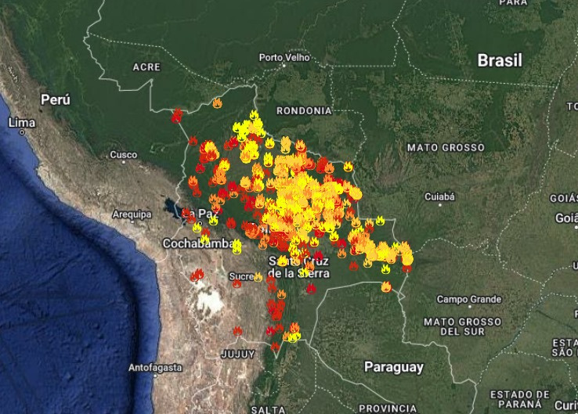
EVA
“Wake up, the world is changing. Discover the Effect of wildfires with a click”
With an interactive map and the Mallku chatbot, E.V.A. teaches dynamically about fires, pollution and their effects.

Slide 6
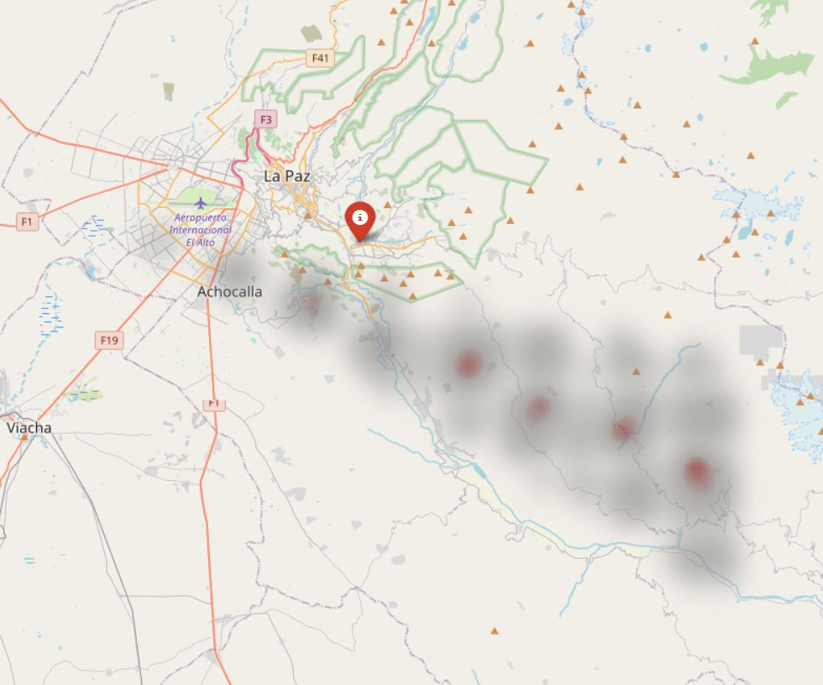
Our solution bridges the information gap in youth, providing an interactive and educational experience that opens the eyes to the environmental reality the moment the user opens the application, he is greeted by an interface designed to facilitate access to information,

Slide 7
THANKS
FOR WATCHING

